Slide 1

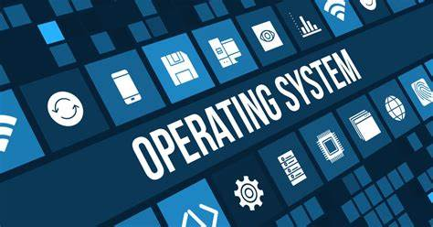

Evolution of windows operating system
Presented by Abhay Kumar
Final BTech Information Technology
Roll No. : 200106015
HBTU, Kanpur
Get ready to explore the heartbeat of modern computing.
Welcome to our presentation on operating systems! In this presentation, we will explore the overview and the evolution of windows operating system.

Slide 2
Table of Content
What is Operating System?
Key Functions of an Operating System
Windows Operating system
Windows 1.0
Windows 2.0
Windows 3.0
Windows 95
Windows 98
Windows 2000
Windows ME
Windows XP
Windows Vista
Windows 7, 8, 10, 11

Slide 3
What is an Operating System?
Overview
Resource allocation
An Operating System, or OS, is the software that manages computer hardware and software resources.
The OS is responsible for managing and allocating resources like memory, CPU, and peripherals.
Interface
Security
It provides a user interface for interacting with the computer and manages tasks
The OS provides security features to protect against unauthorized access and malicious software.

Slide 4
Key Functions of the Operating System
Memory Management: Just like a teacher dividing desks for students, the OS allocates memory space to different programs so they don't interfere with each other.
Managing Hardware: OS oversees computer hardware, like the CPU, memory, and storage, ensuring everything works together smoothly.
Task Scheduling: Imagine a chore chart. The OS schedules tasks, giving each one a turn, so your computer doesn't get overwhelmed.
Providing User Interface: Think of it as the translator between you and the computer. It offers ways to interact, like clicking icons or typing commands.
Process Management: It's like a traffic cop for programs. The OS decides which program gets CPU time, so everything runs without jams.
Device Management: It's like handling gadgets. The OS talks to printers, screens, and more, making sure they understand what you want.
File Management: The OS helps you organize files and folders. It's like arranging your books on shelves so you can find them easily.
Security and Access Control: The OS keeps your computer safe. It manages who can enter (login) and what they can do (permissions).
Error Handling: Just like a superhero fixing messes, the OS detects and deals with errors so your computer stays stable.

Slide 5
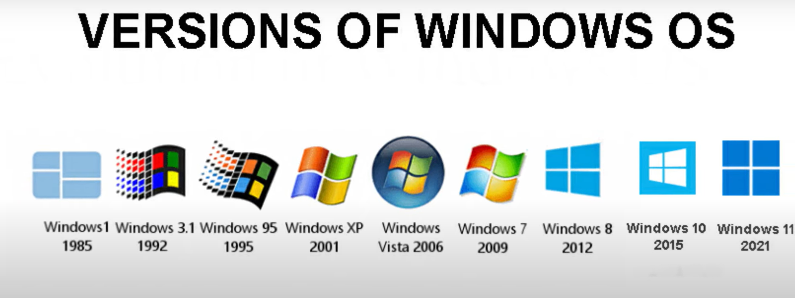
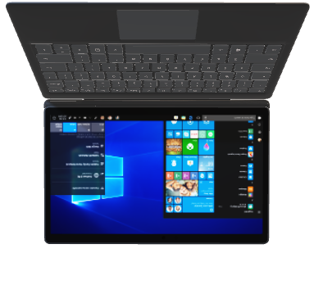
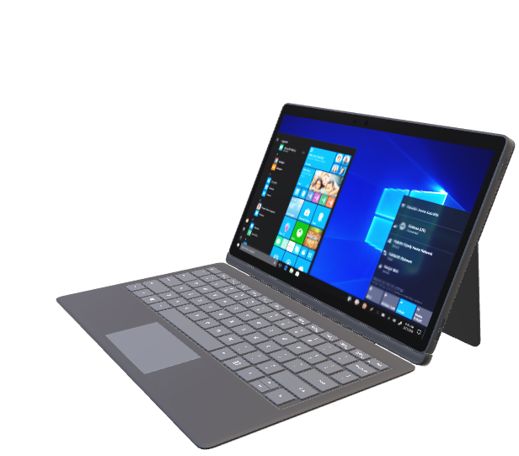
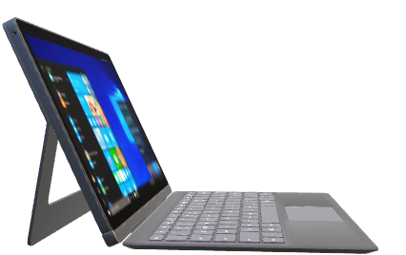
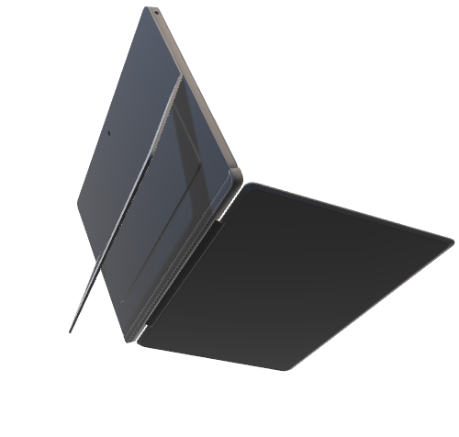
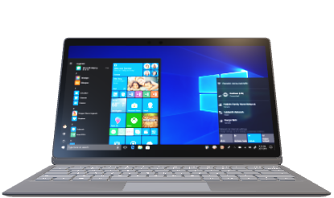
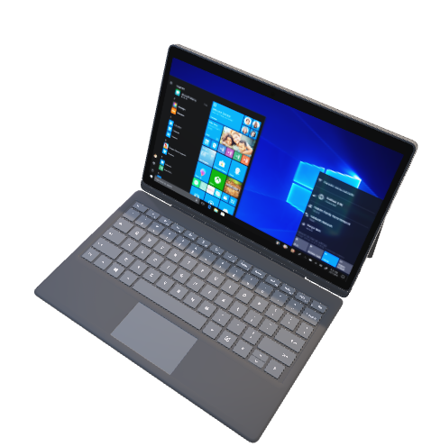
F

Slide 6
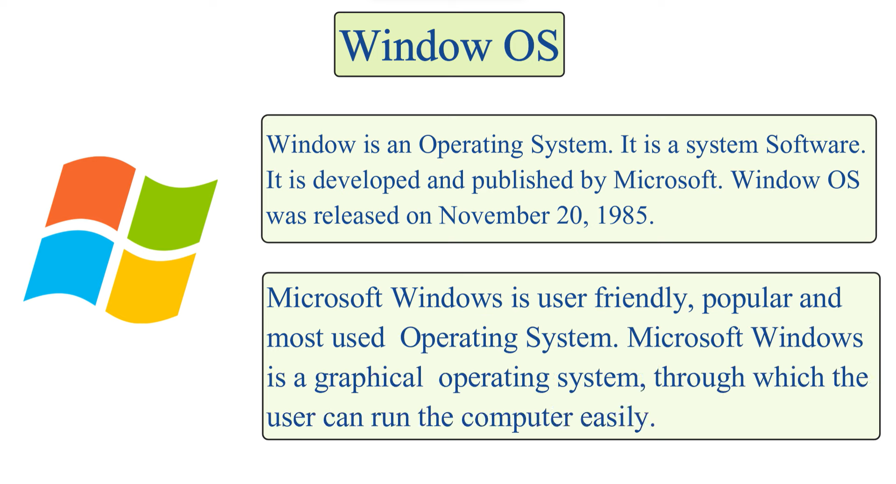

Slide 7
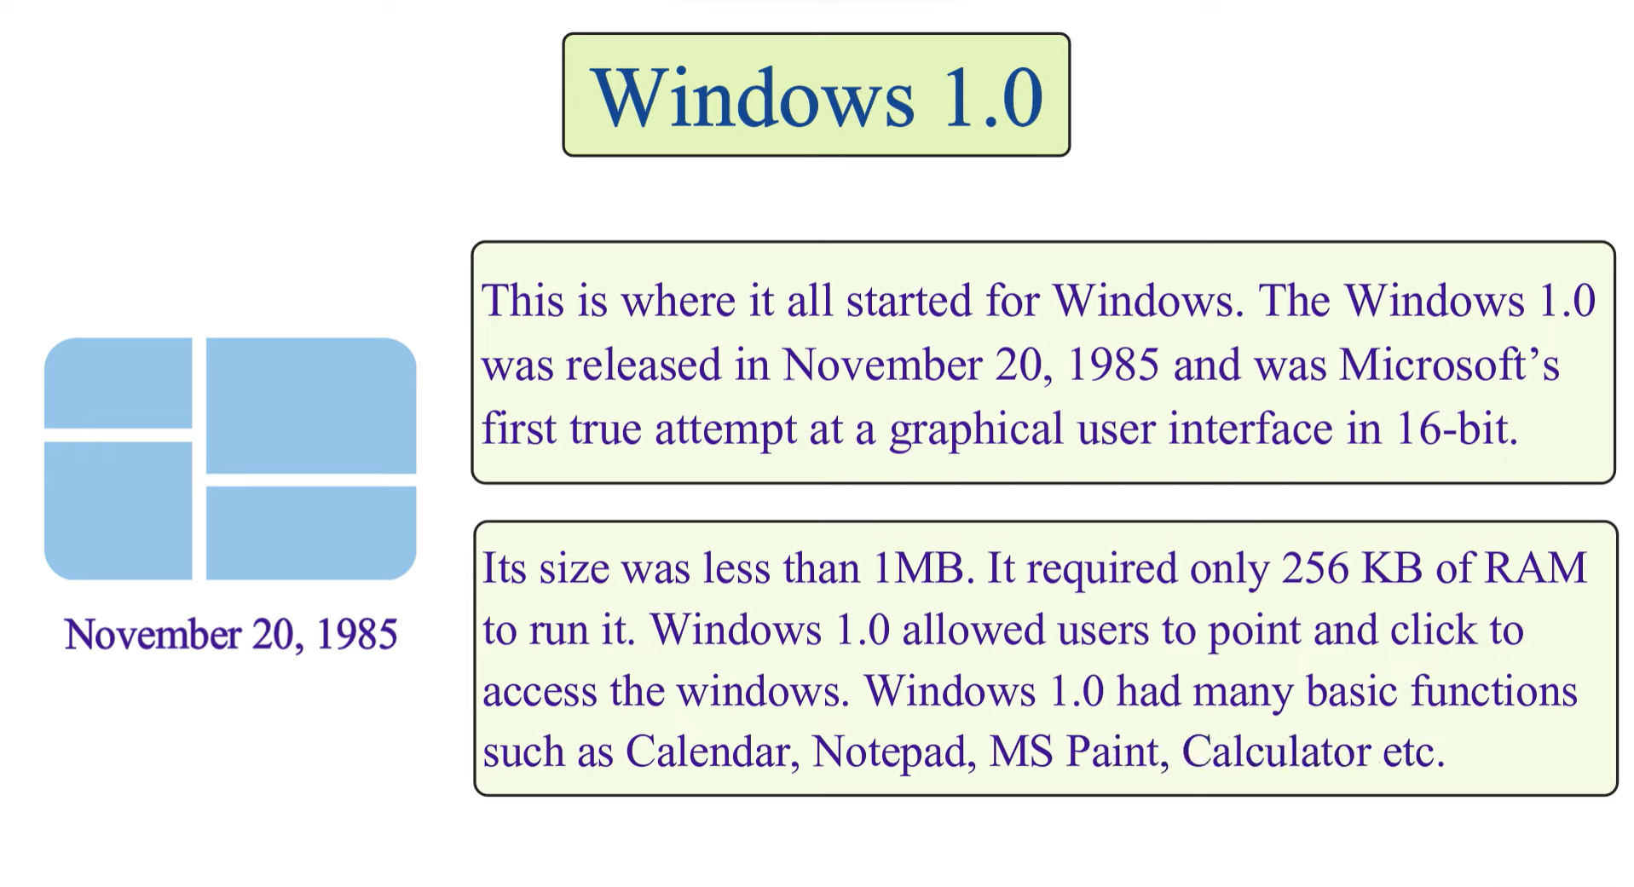
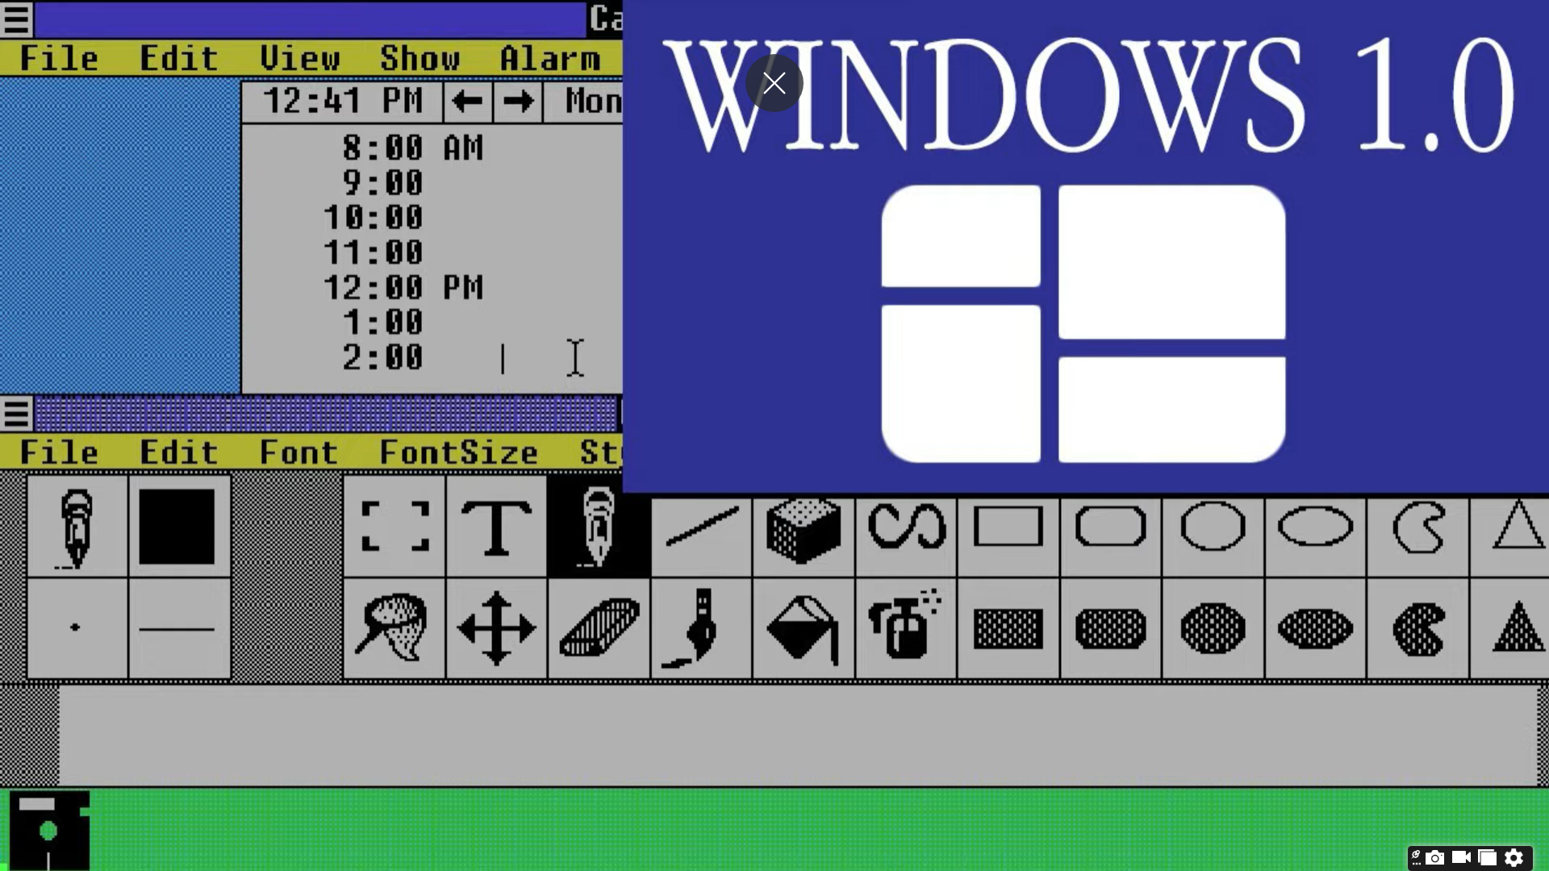

Slide 8
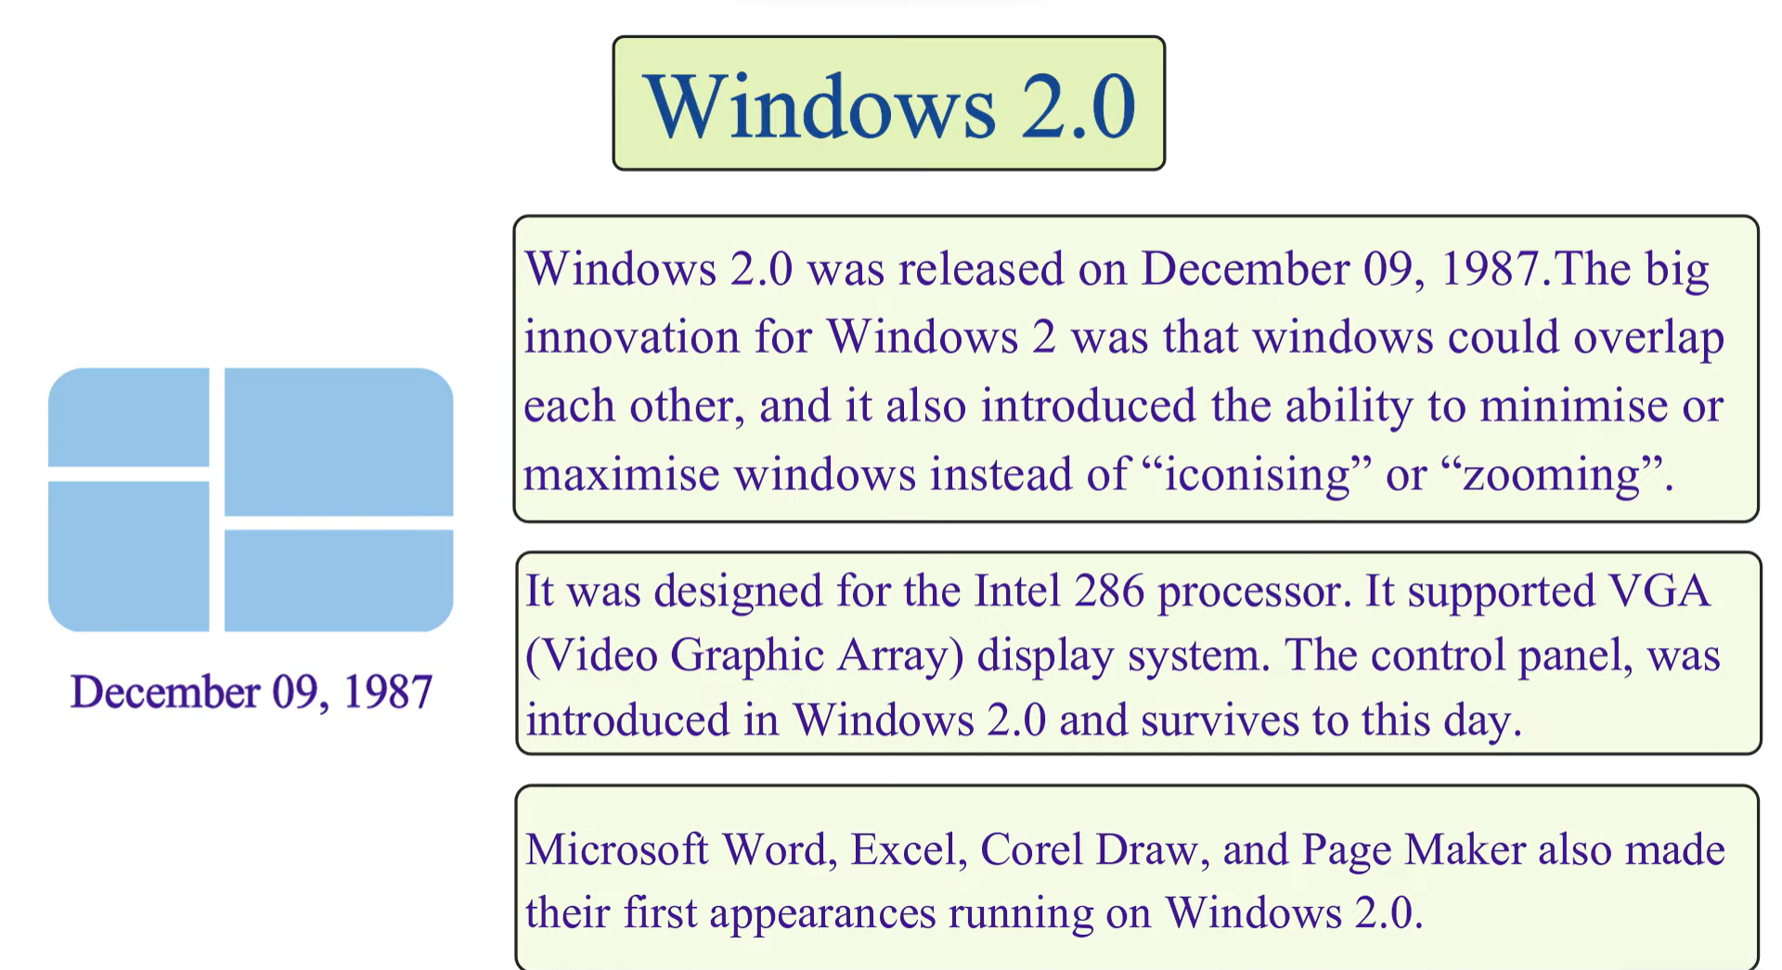
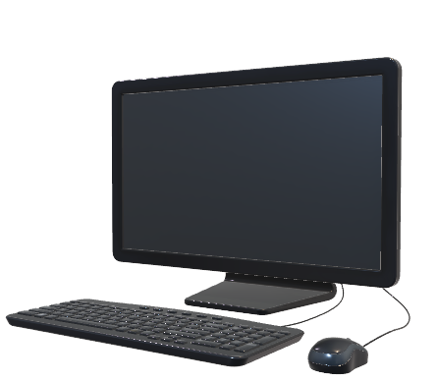

Slide 9
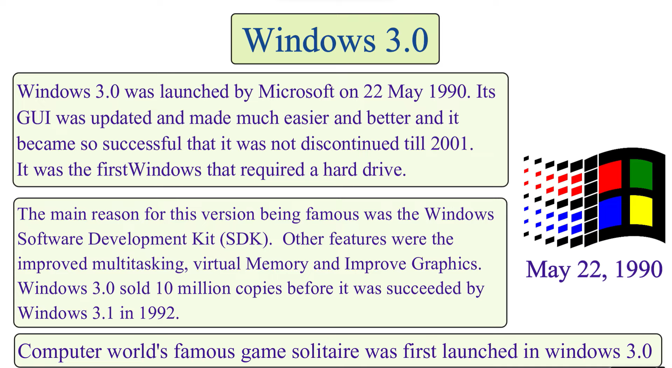
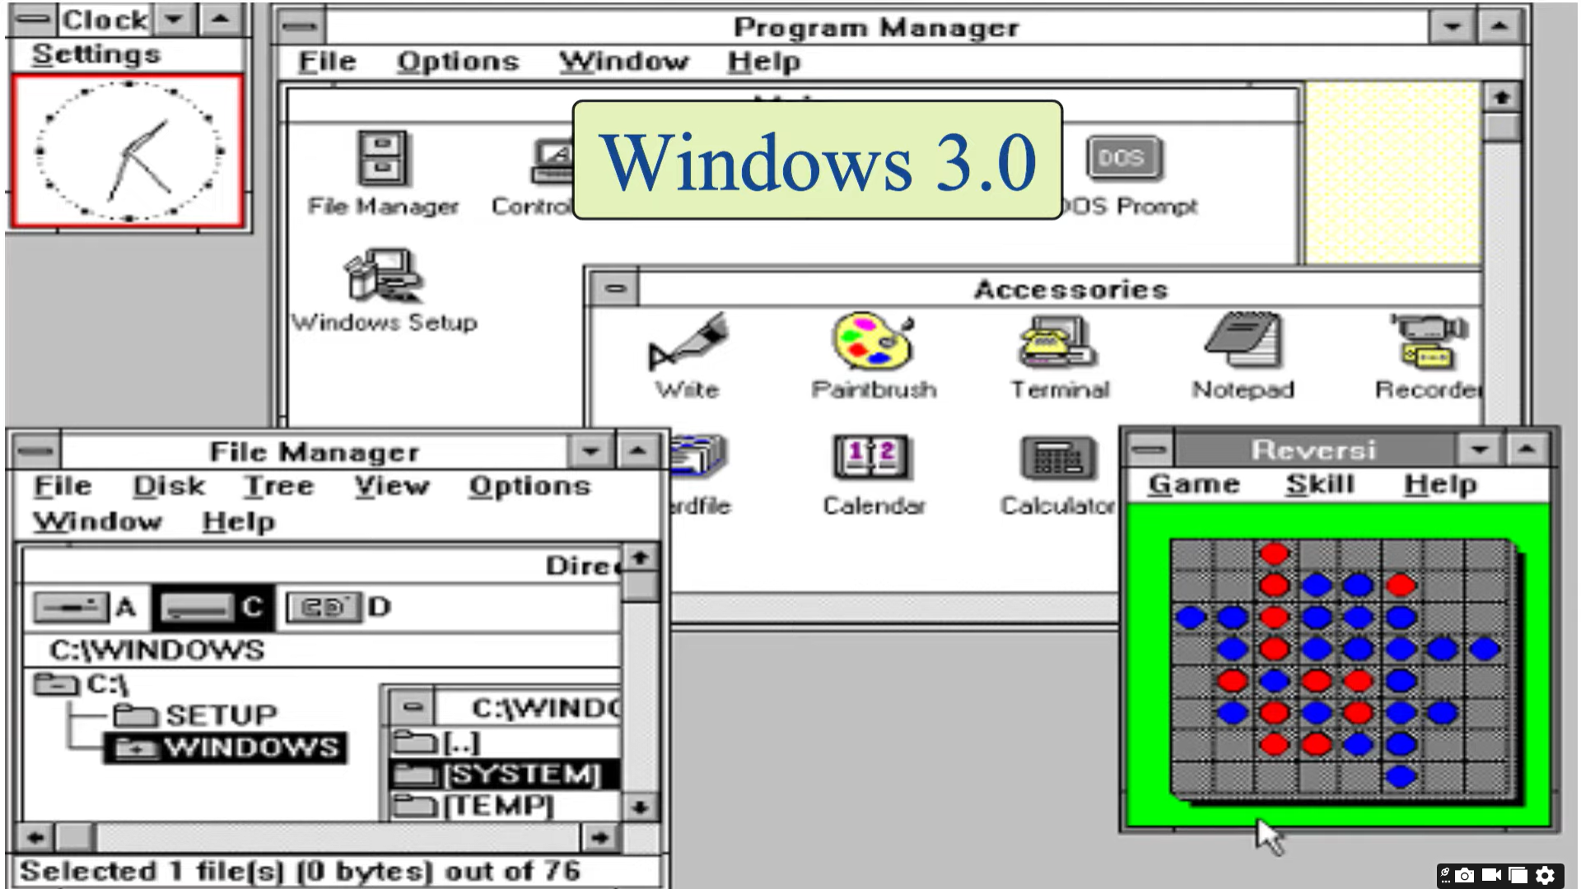

Slide 10
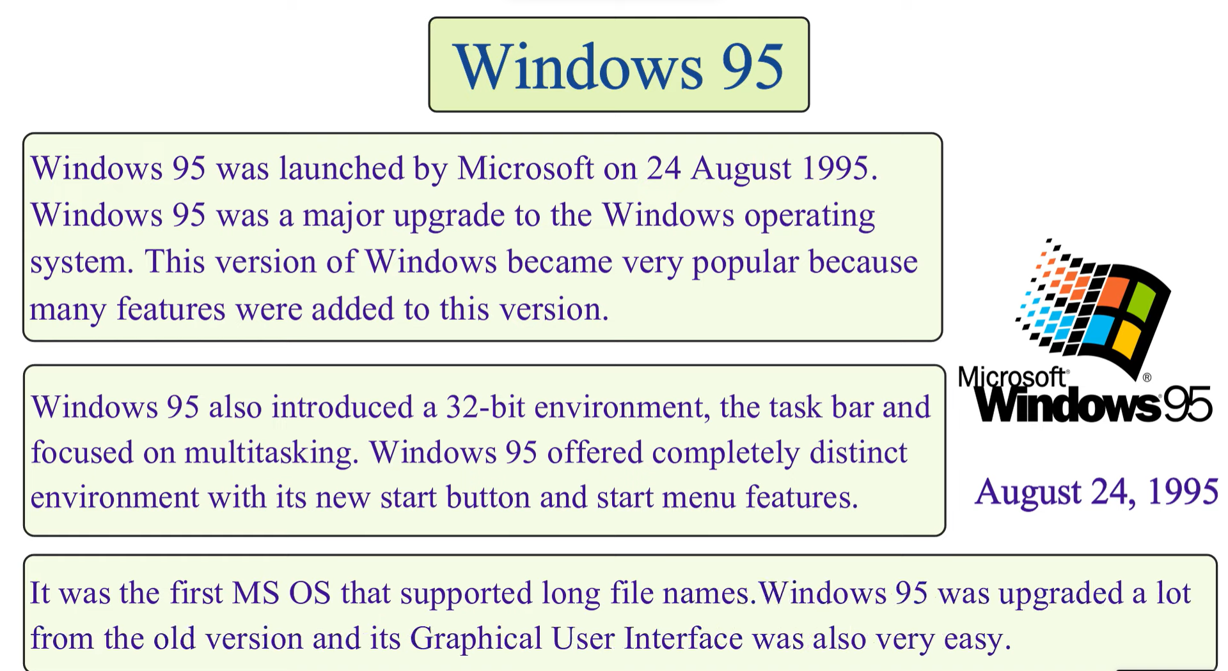

Slide 11
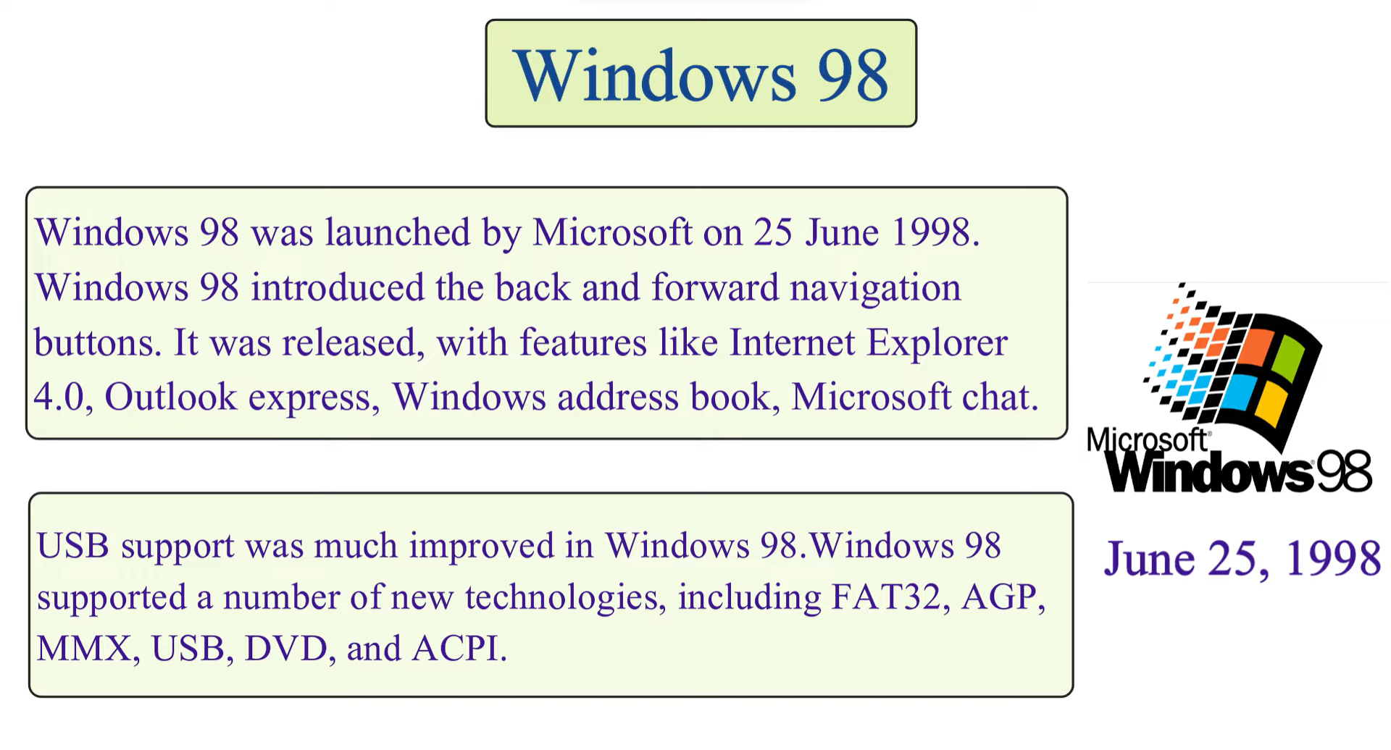

Slide 12
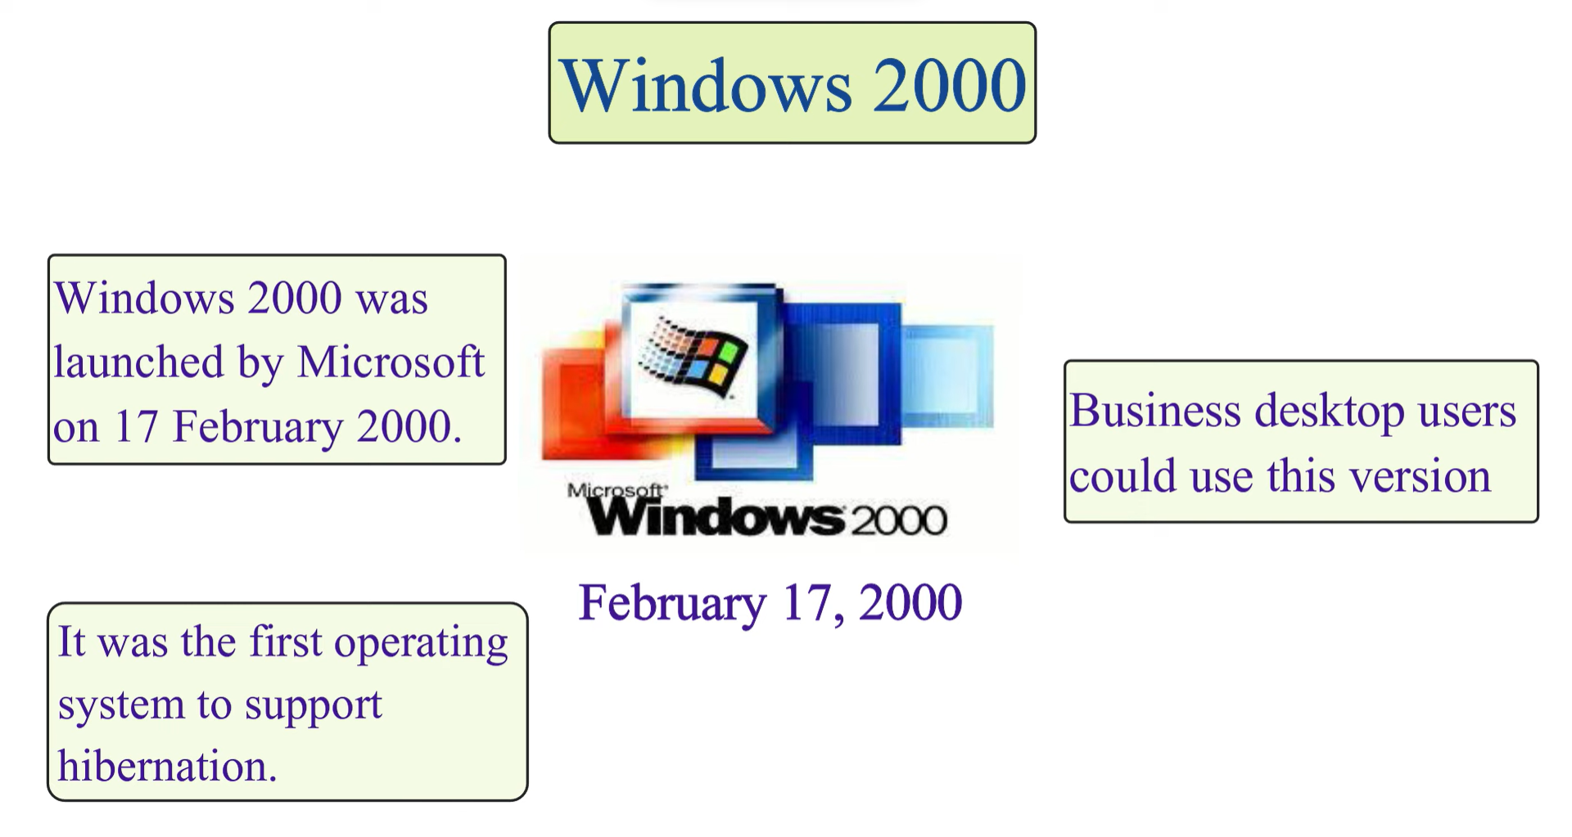

Slide 13
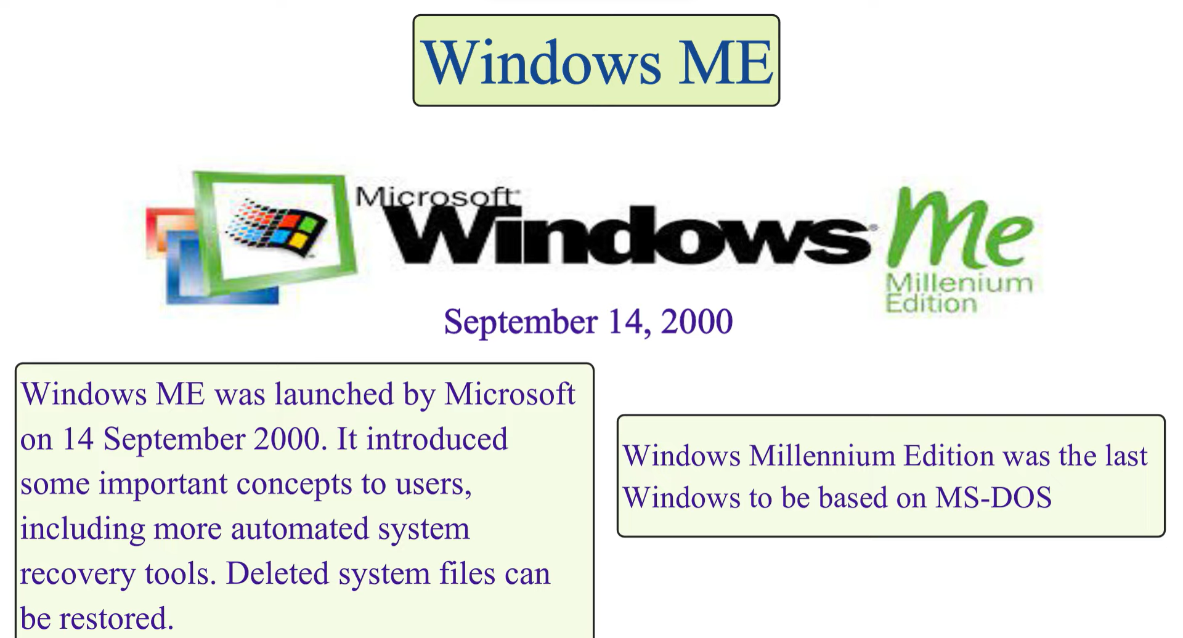

Slide 14
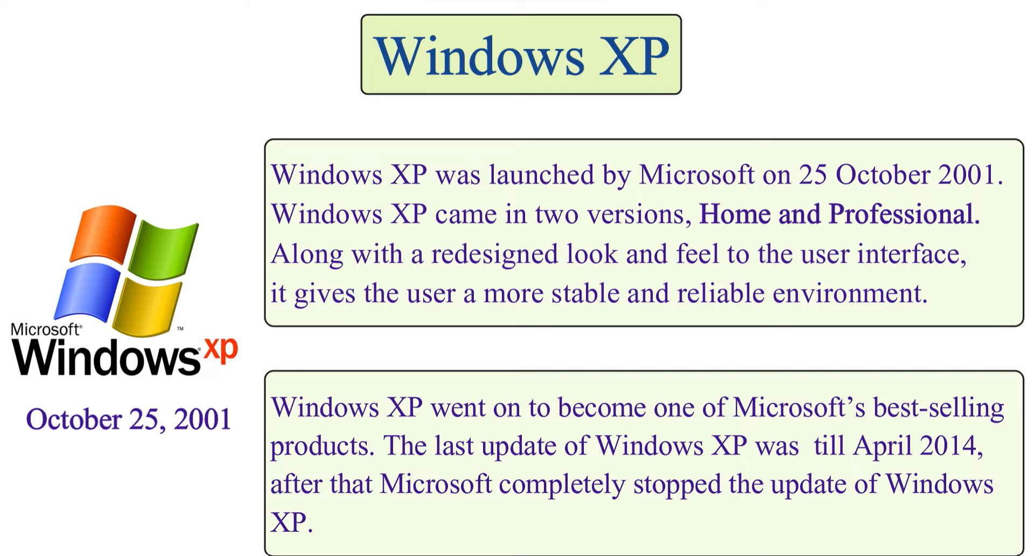

Slide 15
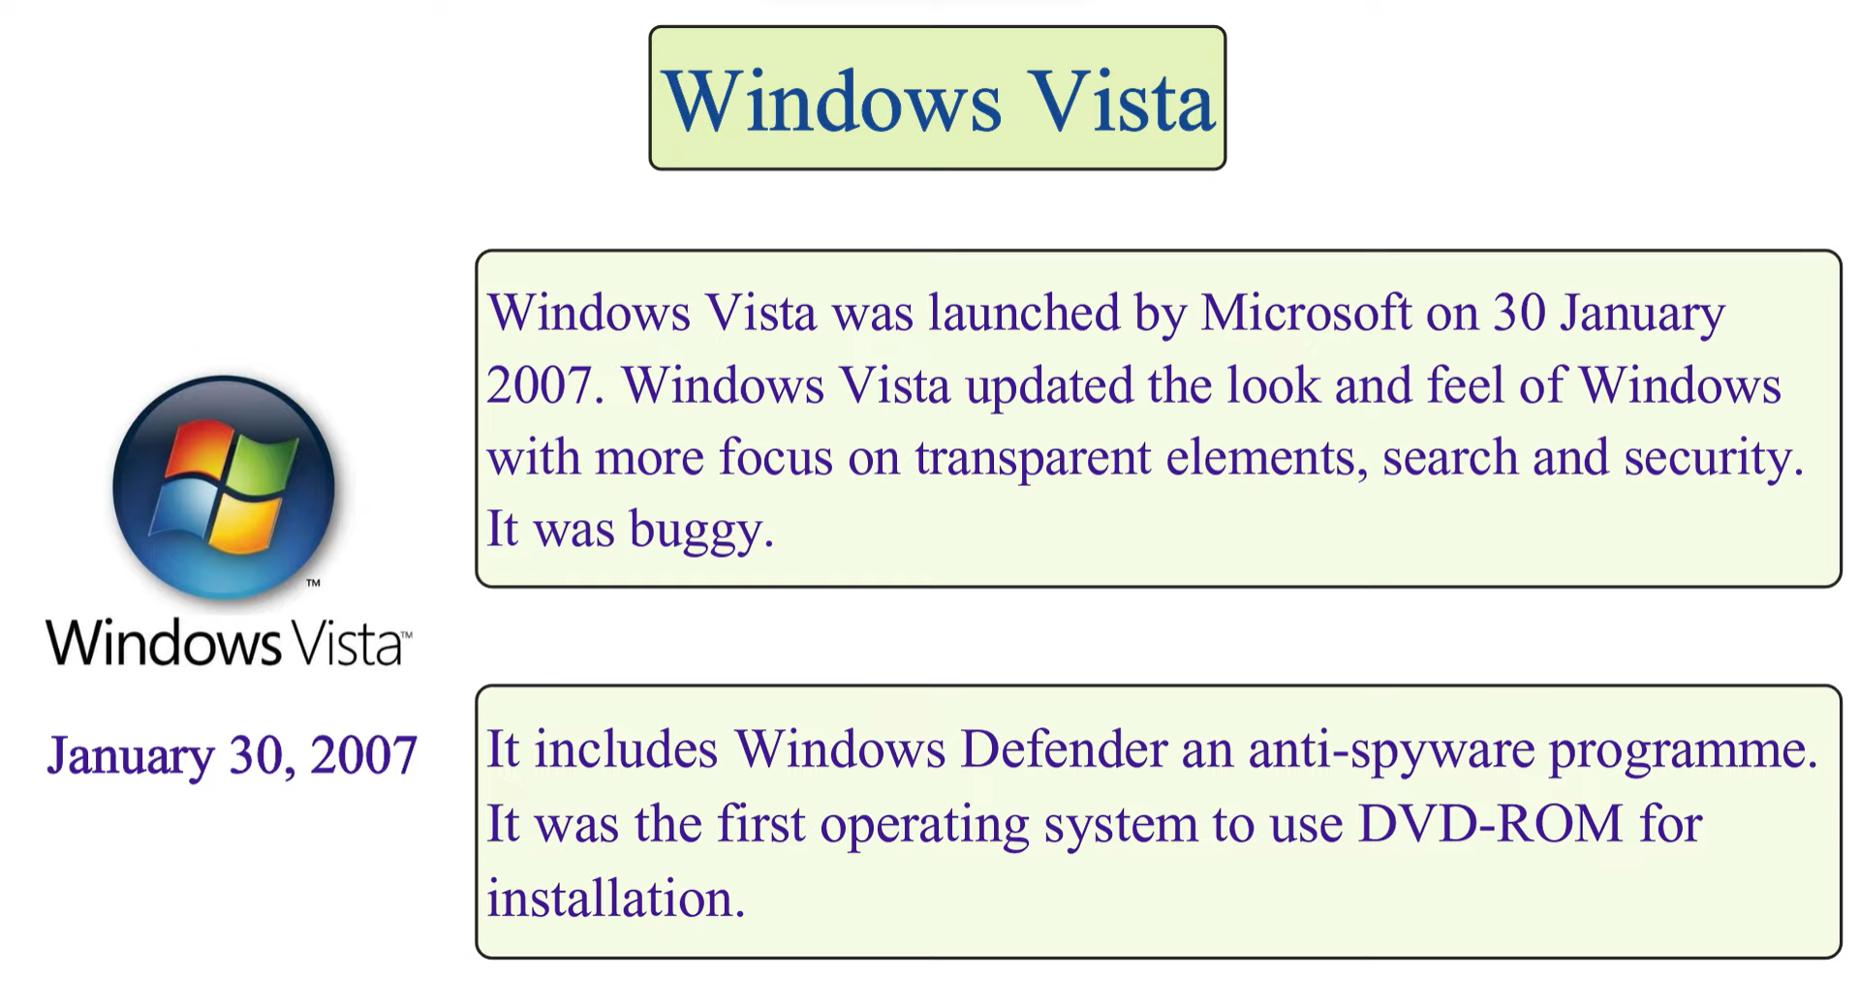

Slide 16
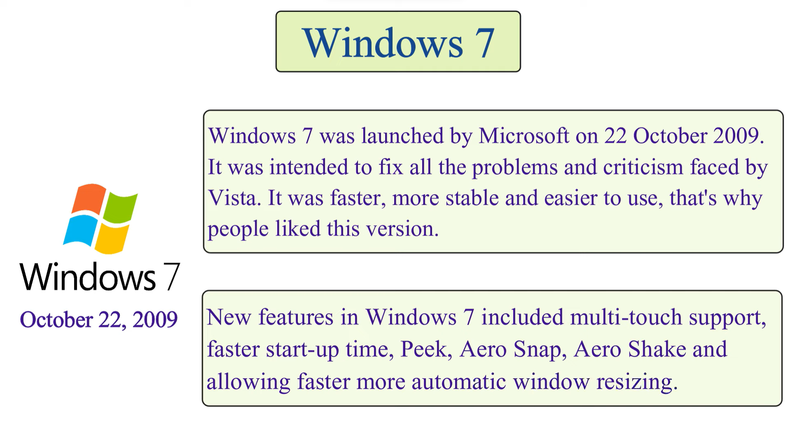

Slide 17
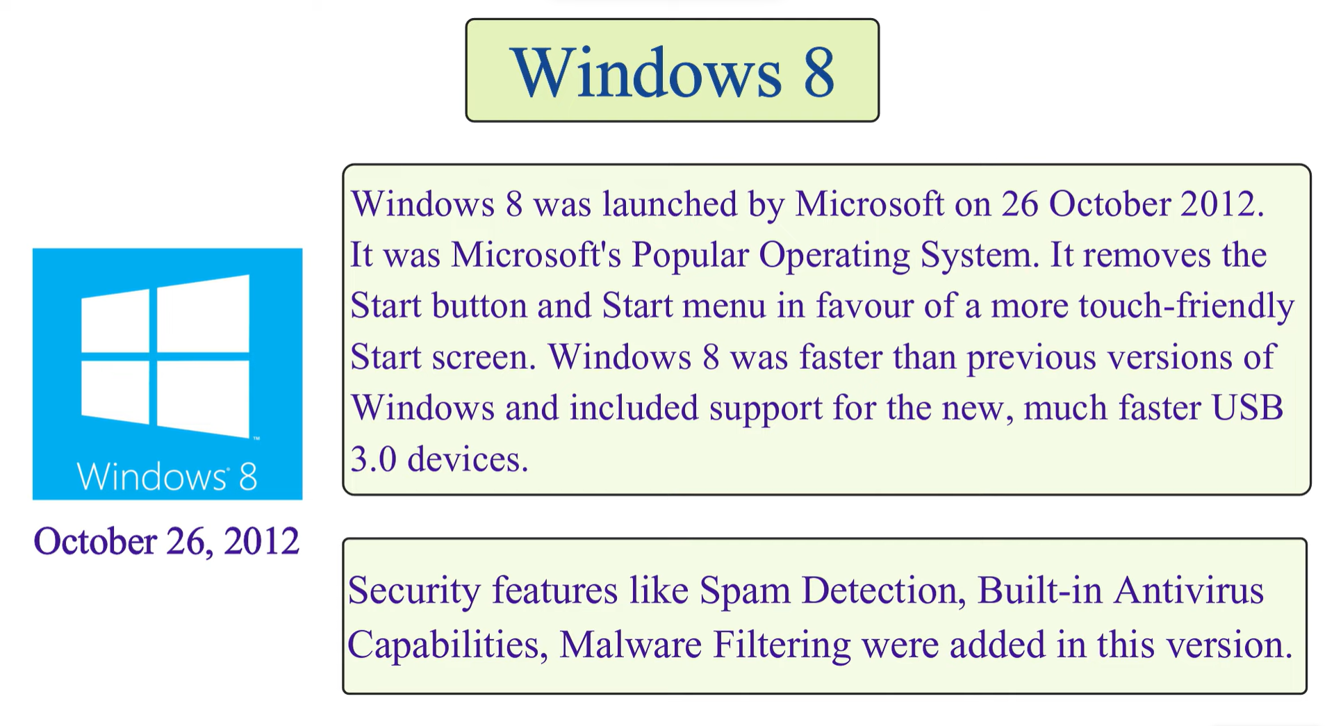

Slide 18
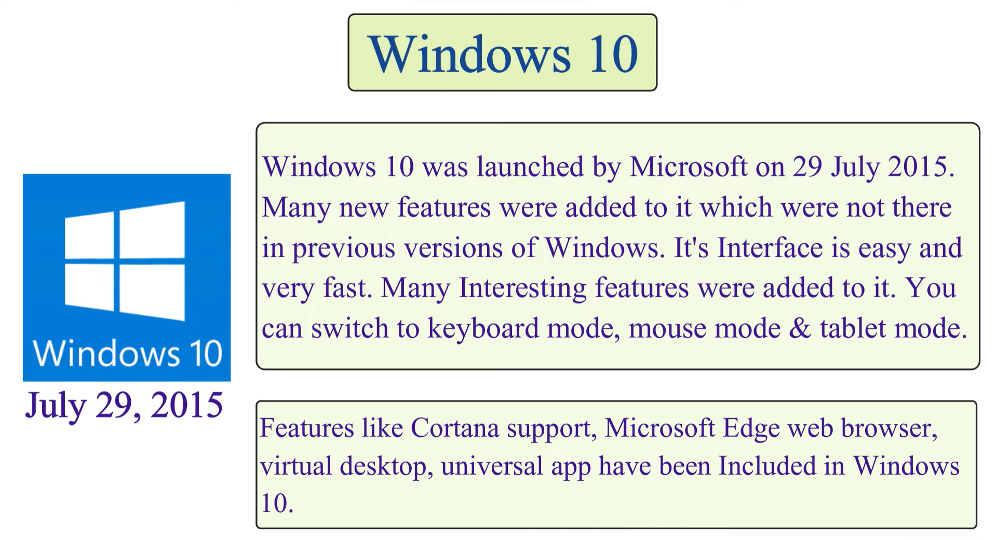

Slide 19
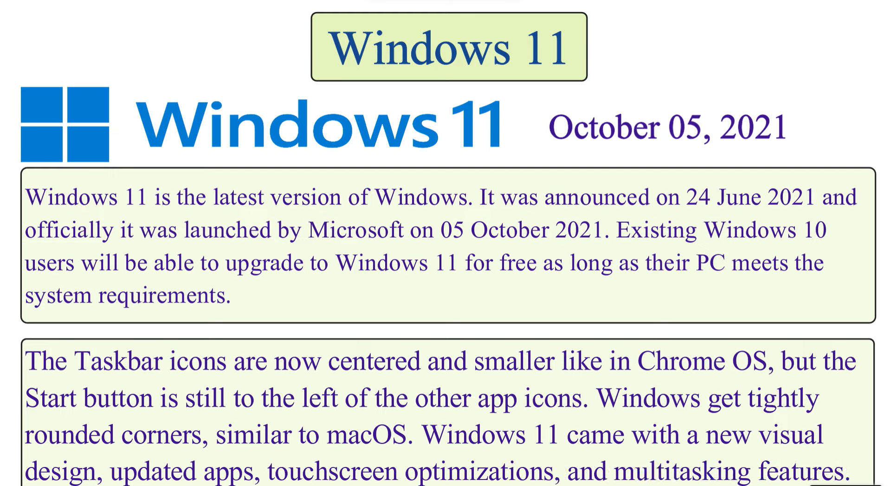

Slide 20
F
In conclusion, an operating system coordinates computer resources, offers a user-friendly interface, manages multitasking, and efficiently organizes data. Just like a conductor guides a musical symphony to create harmony, an operating system brings together these components, ensuring smooth computing experiences for users and optimizing hardware usage.
We have seen a complete evolution of windows operating system.
Thankyou!
Feel Free to ask anything on the points in the ppt in order to understand things more clearly.

